Slide 1
Chicago Crime Analysis
Presented by:
Agent James Rogers

Slide 2
Background
Mayor Breya Walker and Commisioner Melissa Wann reached out to D.A.B. for an in-depth analysis of crime occurring in Chicago so she can revise her budget in an attempt to lower crime
Agent James Rogers, D.A.B.s top analyst was tasked to identify a root cause for the rash of crime being committed throughout the city
Agent Rogers combed the web for datasets and found:
https://data.cityofchicago.org/Public-Safety/Crimes-2001-to-present/ijzp-q8t2
https://www.ncdc.noaa.gov/cdo-web/datasets
https://crime-data-explorer.fr.cloud.gov/downloads-and-docs
Excel and Python were the primary tools deployed to review .csv files to conduct an analysis on the years 2017 - 2018

Slide 3
Overview
Purpose:
To analyze Chicago crimes and their correlation to certain conditions. Do specific factors contribute to crime rates?
Nature of Crime in Chicago
Crime Analysis
When does crime occur
Where does crime occur
Types of Crime
Findings upon conducting research
Trend Analysis
Crimes by Climate
Crimes by Demographic
Gender
Age

Slide 4


Nature of Crimes
Onward toward Trend Analysis
5
4
Types of Crimes Committed 17/18
Crimes by Location 17/18
3
Crime Totals by Month 17/18
2
Natures of Crimes Begins
1

Slide 5
Crime Total by Month 2017

Slide 6
Crime Totals by Month 2018

Slide 7
Crime Totals by Month 2017

Slide 8
Crime Totals by Month 2018

Slide 9
Crime by Location – Wards 2017

Slide 10
Crime by Locations - Wards 2018

Slide 11
Specific Locations of Crimes 2017

Slide 12
Specific Locations of Crimes 2018

Slide 13
Crimes Committed in 2017

Slide 14
Crimes Committed in 2018

Slide 15

Trend Analysis
Transition:
From the Nature of Crime on to Trend Analysis

Slide 16
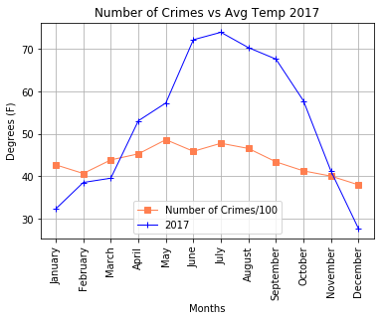
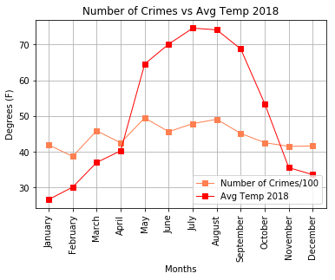
Crimes vs. Avg Temps 2017/2018

Slide 17
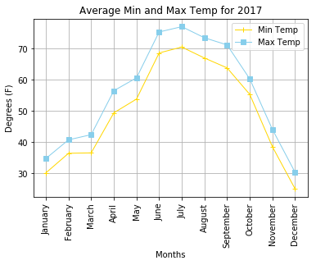
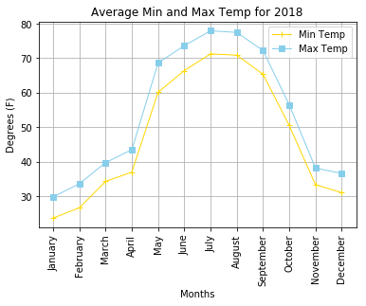
Average Mean/Max Temps 2017/2018

Slide 18
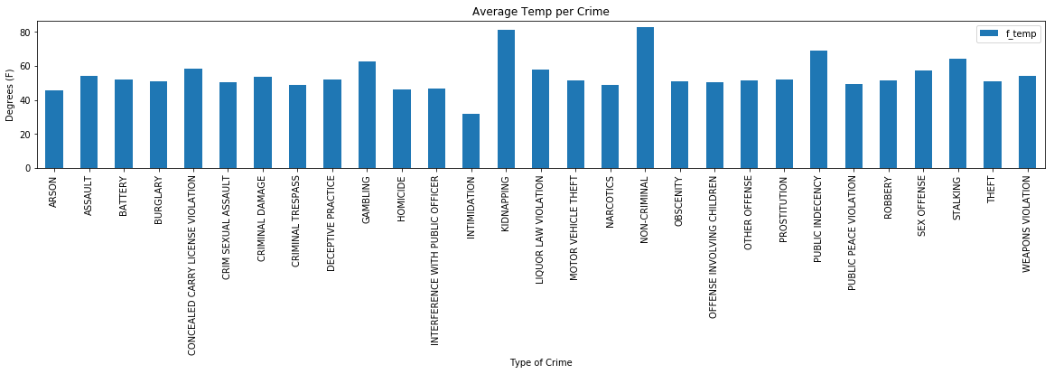
Temps vs. Crime Type 2017/2018

Slide 19
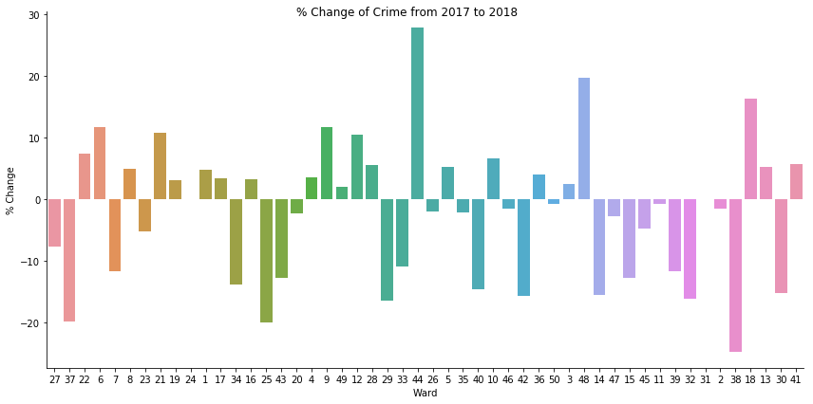
Change in Crime by Location - Wards

Slide 20
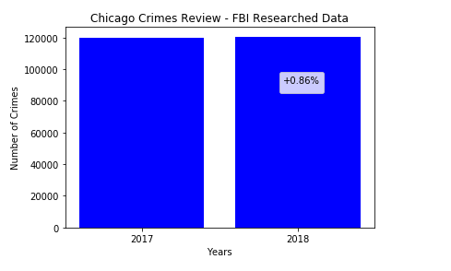
Change in Total Crime – 2017/2018

Slide 21
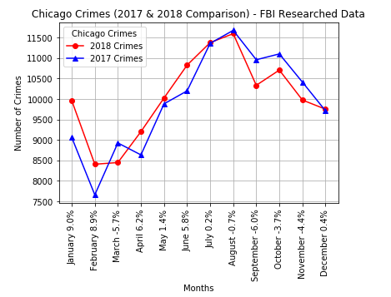
Crime by Year by Month 2017/2018

Slide 22
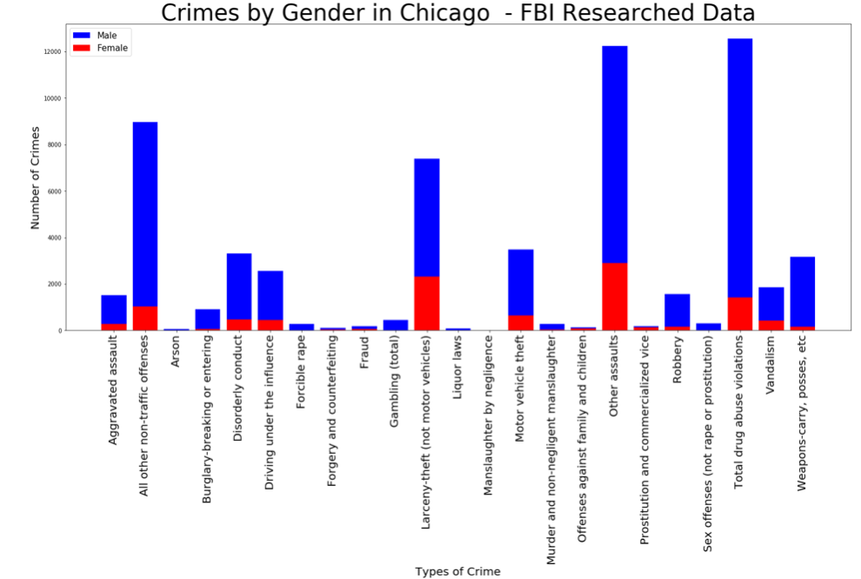
Crime by Gender 2017/2018

Slide 23
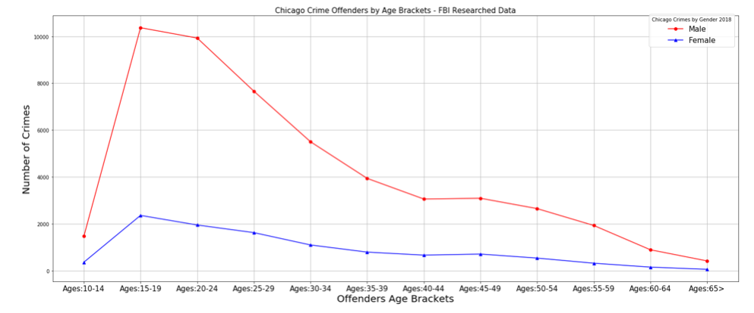
Crime by Age 2017-2018

Slide 24
Chicago School Calendar 2018

Slide 25
Findings
Onward toward Data Derived Facts
5
4
Crime by Age
Crime by Gender
3
Crime vs Climate
2
Trend Analysis Begins
1

Slide 26
Data Derived Facts
Agent James Rogers’ Data Analysis Reveals:
1
Crimes increased in Chicago from 2017-2018, trending upward
2
Crimes occurred in specific locales, Heaviest crime: Ward 24, 28, & 42
3
Weather influenced crime, more likely to occur in summer months
4
Crime peak months correlated with start/stop of the school year
5
Men were more likely to commit a crime than women
6
Crime peaked at early childhood on into adulthood

